Slide 1
Okaloosa County Board of County Commissioners
Group Insurance
2020

Slide 2
Agenda
Life Insurance
Long Term Disability

Slide 3
Life Insurance
Securian Financial Group, Inc.

Slide 4
Basic Term Life Insurance
Employer paid
$25,000*
Active employees working 30 hours per week
Includes a matching Accidental Death and Dismemberment (AD&D) benefit
*Benefit reduces beginning at age 65

Slide 5
Supplemental Term Life Insurance
Employee paid - Available to benefit eligible employees
Employee
Elect $5,000 increments up to $500,000 maximum Includes a matching AD&D benefit
Spouse
Elect $5,000 increments up to $250,000 maximum (not to exceed 100% of employee’s basic and supplemental coverage) Spouse rates based on employee’s age
Notes: If your spouse or child is eligible for employee coverage, they cannot be covered as a dependent; A child may only be covered by 1 parent.

Slide 6
Supplemental Life Insurance (continued)
Child Life
Elect in increments of $1,000, subject to a maximum of $10,000, $15,000, or $20,000 (not to exceed 100% of employee’s total basic and supplemental amount)
Live birth to age 26
First newborn child benefit*
*First Newborn Child
is automatically covered for $1,000. To continue coverage, child life must be elected within 31 days from birth, otherwise coverage will terminate at the end of the 31 day period.
New Hire/Qualified Status Change and Annual Enrollment:
Elect without health questions!

Slide 7
Annual Enrollment Guaranteed Issue Opportunity
Enroll during open enrollment without health questions
The following options are available without needing to provide evidence of insurability!
Employees
Elect for the first time or increase current coverage by $25,000
Not to exceed $300,000*
Child
Elect or increase up to $20,000
One election, insures all children live birth to age 26
*Maximum guaranteed amount includes coverage currently in force.
Employees enrolling beyond $25,000 or for amounts that exceed $300,000 will require evidence of insurability and underwriting approval.
Enrolling your spouse will require evidence of insurability and underwriting approval.

Slide 8
Value Added Services and Resources
Securian Financial Group, Inc.

Slide 9
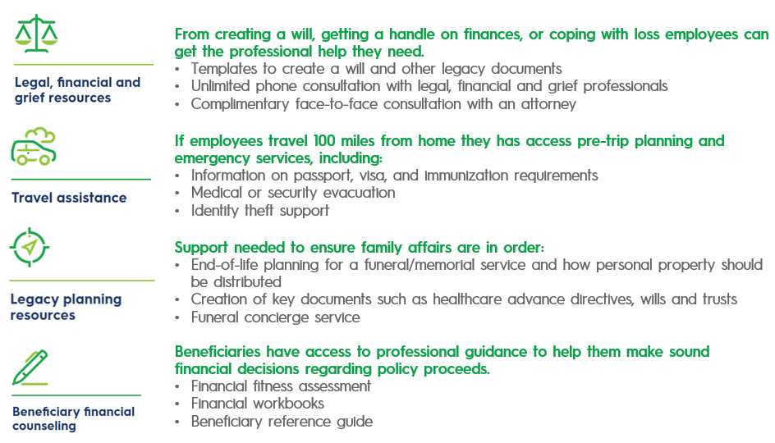
Lifestyle Benefits
No additional cost for Life Insurance participants

Slide 10
EOI and Additional Plan Details
Securian Financial Group, Inc.

Slide 11
Evidence of Insurability
On page 1 of the form - only enter amounts that require underwriting and be sure all 3 questions are answered as well as height & weight.
Enter the amount that needs to be underwritten. Guaranteed Issue amounts should not be included.
Enter Employee and Spouse Height and Weight for coverages elected.
Answer all 3 questions for coverages elected.

Slide 12
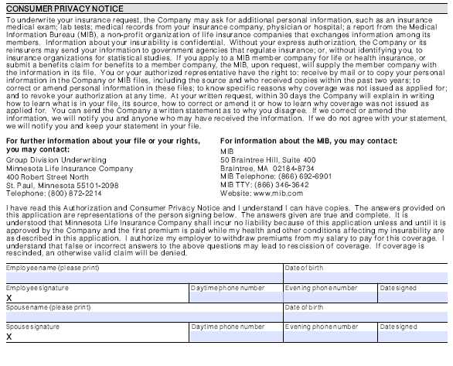
Evidence of Insurability
On page 2 of the form - signatures are required for employee and spouse!
Employee signature is needed for all elections and both signatures are needed when enrolling your spouse/domestic partner.

Slide 13
Accelerated Benefit (Living Benefit)
Employee, Spouse or Child Life
Up to 100% of benefit amount can be paid while living if insured has less than 12 months to live
Amount not accelerated and paid while alive, will be paid to the designated beneficiary

Slide 14
Waiver of Premium (Disability Waiver)
Premium is waived if the insured becomes totally and permanently disabled, as defined by the policy, while under age 60.
Permanent disability is defined as a total disability that has existed for at least 6 months.
Upon approval, employee and dependent insurance will continue without payment of premium to the earlier of:
Retirement
Recovery
Age 65

Slide 15
Portability or Conversion
Take your coverage with you...
If an employee is no longer eligible for coverage as an active employee due to voluntary or involuntary termination of employment (including retirement), they may be able to continue employee and dependent in-force life insurance coverage, without having to provide evidence of insurability.
Get more information from your Benefits Office or contact Ochs: 1-800-392-7295 / ochs@ochsinc.com
Portability
Port coverage with Minnesota Life
Term life policy
Conversion
Convert coverage to Minnesota Life
Whole life policy
Coverage reduces with age and terms at age 70
Coverage remains in force until death
Rates increase with age
Often the most expensive option
Note: Premiums may be higher than those paid by active employees.

Slide 16
Long Term Disability
Madison National Life Insurance Company, Inc.

Slide 17
Core Long Term Disability Insurance
Employer paid
For Accident or Illness
50% of your basic monthly earnings (monthly max. $3,500)
Active employees working 30 hours or more per week
Benefits begin on the 181st day of a covered accident or illness

Slide 18
Buy-Up Long Term Disability Insurance
For Accident or Illness
You have the option to purchase additional coverage to increase your benefit to 60% of your basic monthly earnings (monthly max. $5,000)
Evidence of Insurability and underwriting approval required for late enrollees
Benefits begin on the 181st day of a covered accident or illness

Slide 19
Value Added Services and Resources
Madison National Life Insurance Company, Inc.

Slide 20
Employee Assistance and Identity Theft
No cost for Disability Insurance participants
Stress management
Anxiety
Addictions
Eating disorders
And more
Assessing the fraud scope
Providing law contacts
Filing complaint & affidavit
Guidance through recovery
And more
Employee Assistance Program
Identity Theft Services
Confidential Help 866-451-5465 or www.niseap.com (pw: NISenhanced)
MyIDCare 855-205-6010

Slide 21
Need More Information?
CONTACT OCHS
Toll Free:
1-800-392-7295
Email: ochs@ochsinc.com
OR CORPORATE BENEFITS
Phone: 850-244-0849
Have Questions?

